Slide 1
Understanding Audio stack

Slide 2
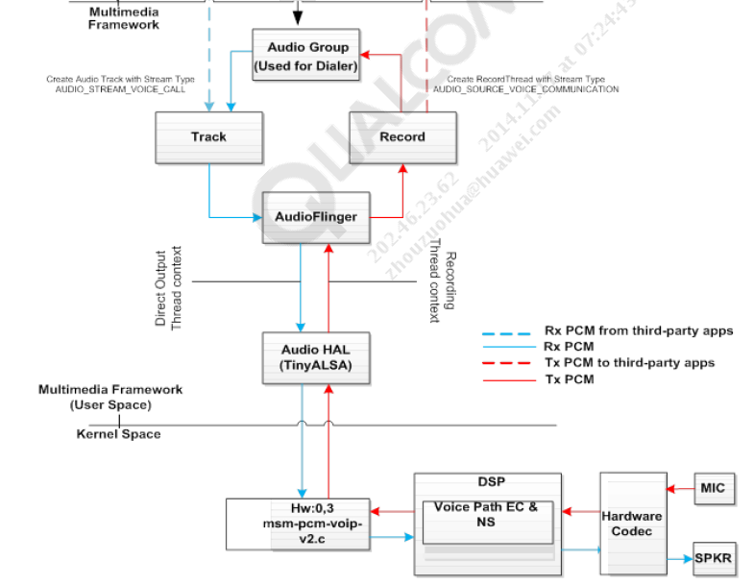

Basic Audio data flow
ASoC driver

Slide 3
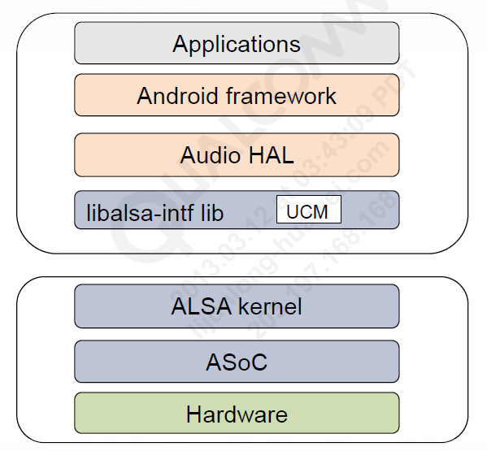
library that provides C API
8960
As there are a lot of mixer controls exposed, UCM in the ALSA lib abstracts them from the applications for different use cases.
ALSA STACK
Component
Codec driver
Platform driver
Machine driver
CPU driver (CPU means DSP)
ASoC core marshals all ALSA PCM calls to all components
Supports frontend and backend DAIs
Supports complex routing between frontend and backend DAIs
DAPM module in ASoC minimizes power consumption
ALSA kernel abstracts PCMs and controls
ALSA library exports API to configure and control PCM streams
ALSA kernel receives the ALSA library calls via IOCTL()s
ALSA core calls ASoC PCM core
ASoC PCM core marshals each PCM call to all components within that audio stream
ASoC checks component PCM call return values for errors and cleans up after errors
Low Power Audio Subsystem (LPASS)
Internal audio codec
Multicore apps processor
Bluetooth/FM chip

Slide 4
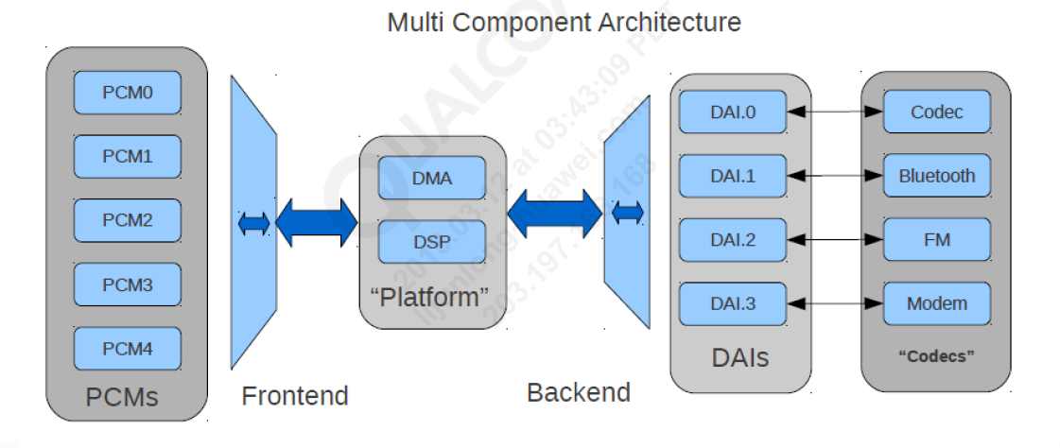
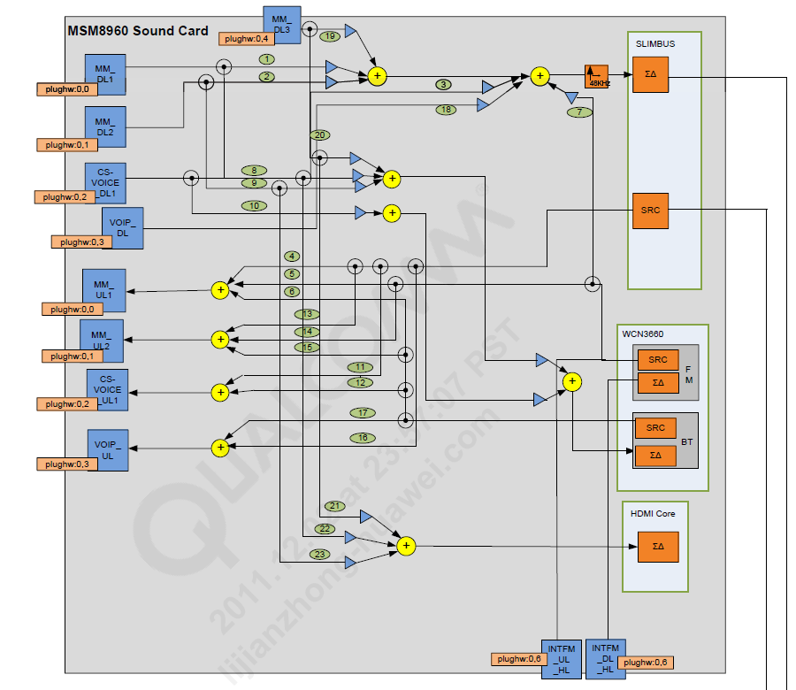
ASoC Architecture
The list of PCM devices can be found in /dev/snd or cat /proc/asound/pcm
route one or more PCM streams from frontend DAIs to one or more backend DAIs, depending on the use case.
Routing of the PCM from frontend to backend is controlled by the user space via mixer controls.
stream devices within the file system and behave as the source or sink for the PCM stream.
Is not visible to user space
Can route audio to multiple frontend DAIs
PCM operations are performed by frontend
Can route audio to multiple backend DAIs
Routing is controlled by user space via mixer controls
PCM operations are performed directly on frontend DAI by ALSA core
kernel/sound/soc/msm-pcm-q6.c
Routing in DSP
Front end
Back End

Slide 5
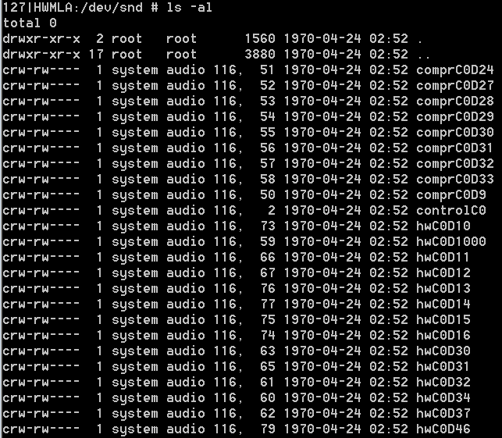
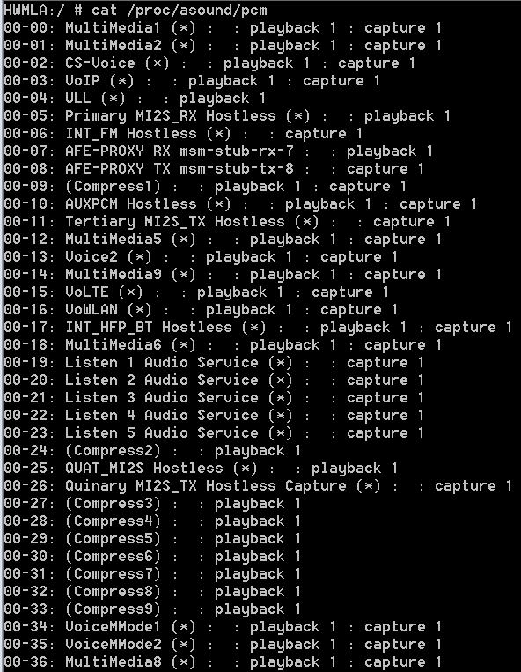
PCMs
stream devices within the file system and behave as the source or sink for the PCM stream
File type operations can be performed on these devices.
PCM streams from frontend DAIs to one or more backend DAIs

Slide 6
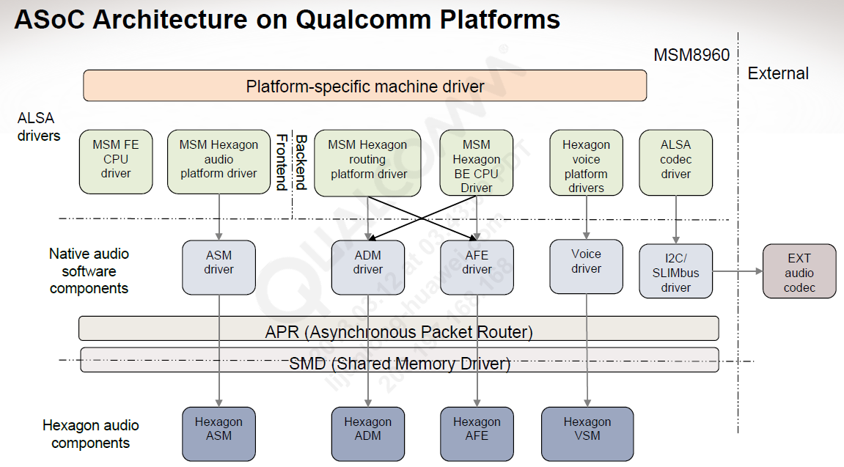
sound/soc/archname/<chipset name>.c example, 8960.c
Defines the AsoC sound card configuration
Define how the components interact with each other
Physical DAI links between the codec, DSP, and CPU
Relationships between each component
Audio capabilities − Rates, formats, channels
External devices − Jacks, amplifiers
Power management − Connected codec pins, modems, FM
Provides asynchronous framework for interprocessor communication;
used to communicate with Hexagon and modem processor
MSM frontend CPU driver − /kernel/sound/soc/msm/msm-dai-fe.c
MSM Hexagon audio platform driver − /kernel/sound/soc/msm/msm-pcm-q6.c
MSM Hexagon routing platform driver − /kernel/sound/soc/msm/msm-pcm-routing.c
MSM Hexagon backend CPU driver − /kernel/sound/soc/msm/msm-dai-q6.c
Q6 voice platform drivers − kernel/sound/soc/msm/msm-pcm-voice.c and msm-pcm-voip.c
ALSA codec drivers − /kernel/sound/soc/codecs/wcd9310.c, wcd9310-tables.c, etc. (for WCD9310 codec)
I2C/SLIMbus drivers − /kernel/drivers/slimbus/slim-msm-ctrl.c, slimbus.c
ASM driver − kernel/sound/soc/msm/qdsp6/q6asm.c
ADM driver − kernel/sound/soc/msm/qdsp6/q6adm.c
AFE driver − kernel/sound/soc/msm/qdsp6/q6afe.c
Voice driver − kernel/sound/soc/msm/qdsp6/q6voice.c
Platform-specific machine driver − msm8960.c (for MSM8960), MDM9x15 (for MDM9x15), etc.
AFE − Audio Frontend
ASM − Audio Stream Manager
ADM − Audio Device Manager
VSM − Voice Stream Manager

Slide 7
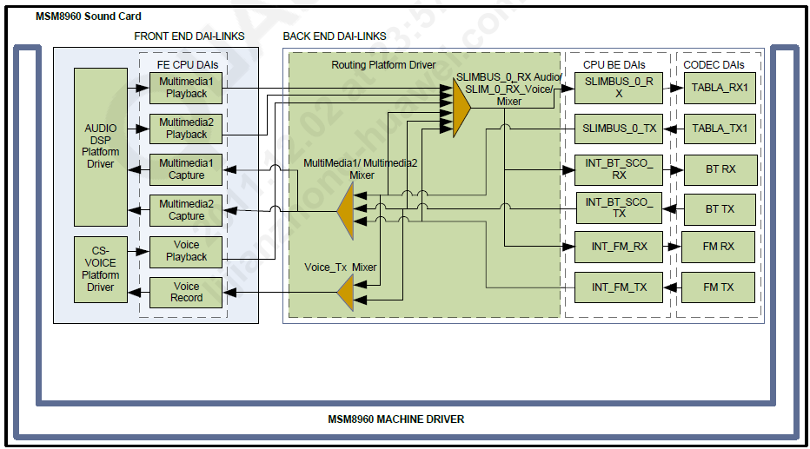
The machine driver binds together the platform, CPU, and codec drivers and defines the Digital 4 Audio Interface (DAI)
The CPU front-end and back-end DAIs are 5 defined in msm-dai-fe.c and msm-dai-q6.c
The platform routing driver is responsible for 6 connecting the front end to the back end, thereby routing the stream as requested. The Front End 7 (FE) and Back End (BE) terms in the context of aSoC driver correspond to Stream and Device 8 respectively.

Slide 8
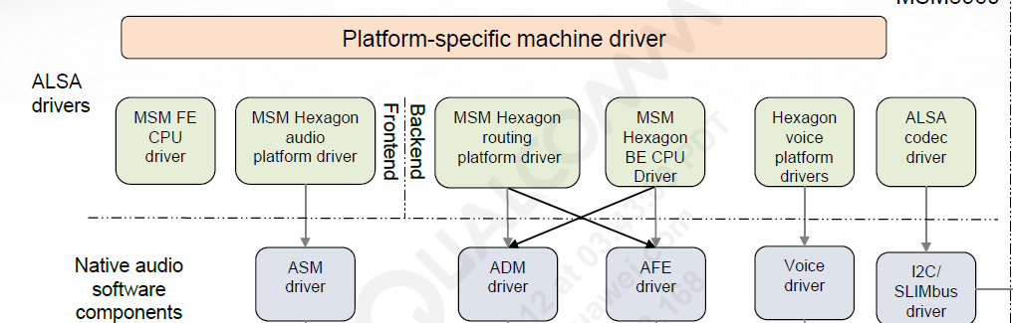
Machine Driver
The machine driver defines the AsoC sound card configuration.
Machine drivers define how the components interact with each other. links between the codec, DSP, and CPU
Relationships between each component
Audio capabilities − Rates, formats, channels
External devices − Jacks, amplifiers
Power management − Connected codec pins, modems, FM
PlatForm Drvier
platform-specific control for stream data transfer and routing
FE
Audio – Instantiates PCM playback and recording sessions; transfers PCM data from user space to DSP for playback and from DSP to user space for recording using ASM interface
Voice – Initializes/deinitializes voice call
VoIP – Initializes/deinitializes MVS interface to transfer PCM data from/to DSP
LPA – Enables transfer of PCM data to DSP for LPA playback
BE
Routing – Performs audio routing tasks
Codec Driver
It is platform-independent and contains audio controls, audio interface capabilities, codec DAPM definition, and codec IO functions
Implements the state machine for MBHC which detects wired headset insertion/removal, accessory type, connector type and multi-button detection.
Abstract the codec hardware functionality:
Capabilities − Rates, formats, channels
Stream PCM operations
DAI hardware capabilities and configuration
Mixers and mux controls
Power management, device enumeration, register I/O
CPU Driver
Provides information about FE PCM devices to ALSA ASoC framework ,along with routing table supplied by platform driver , can direct PCM playback/capture from FE to BE.
No playback and record logic.
Configures DSP AFE module to activate desired audio hardware ports upon initiation of PCM playback/capture

Slide 9
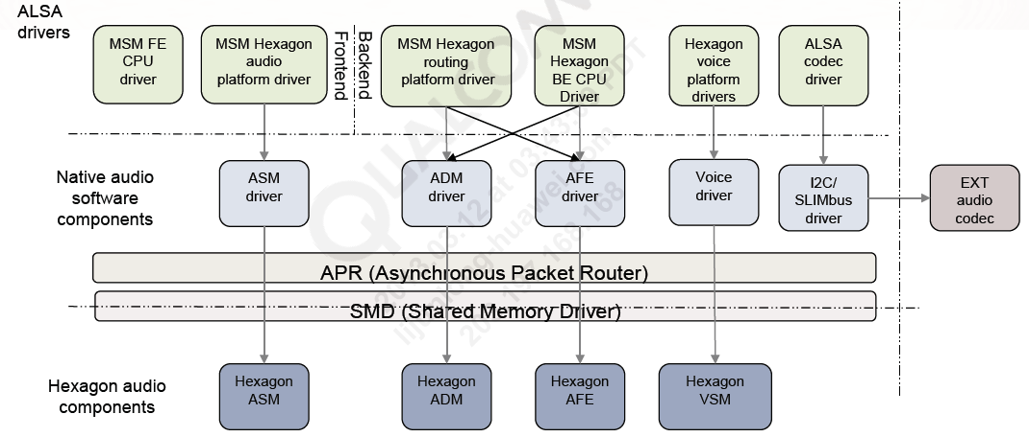
Used For Voice ,, similar as platform driver and ASM
---- More Information Needed
Interface to communicate with DSP ASM module; provides mechanism to route PCM data to DSP with support for post/ preprocessing per stream
Provides the ability to configure the hardware codec and data transfer over SLIMBus interface
Enables ADM service on DSP, configures COPP and routing matrix, communicates with ACDB to configure COPP with proper calibration data, and routes ASM session ID to ADM session
Provides asynchronous framework for interprocessor communication; used to communicate with Hexagon and modem processor
Enables AFE services on DSP, activates/deactivates audio hardware ports

Slide 10
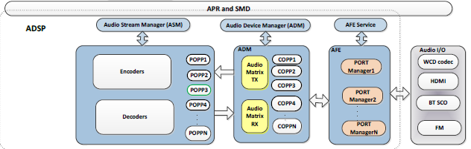

ADSP(Hexagon)
LPASS
Hexagon
FirmWare
MI2S
MI2S
Aux PCM
SLIMBUS Master
CLOCKS

Slide 11
Audio Hardware Interfaces and Data Flow with Internal Codec
HDMI
Analog Codec
LPASS
Speaker
Hexagon
FirmWare
MI2S
Digital Codec
Devices
Headset
Phone
Stereo
Handset
TTY
etc
MI2S
PCM DATA
Aux PCM
SLIMBUS Master
CLOCKS

Slide 12
Audio Hardware Interfaces and Data Flow with External Codec
HDMI
WCD9335/WCD9326
LPASS
Speaker
Hexagon
FirmWare
MI2S
Devices
Headset
Phone
Stereo
Handset
TTY
etc
MI2S
Aux PCM
SlimBus Slave
PCM
SLIMBUS Master
CLOCKS

Slide 13
USE CASES
&
Control/Code Flow in Audio Stack

Slide 15

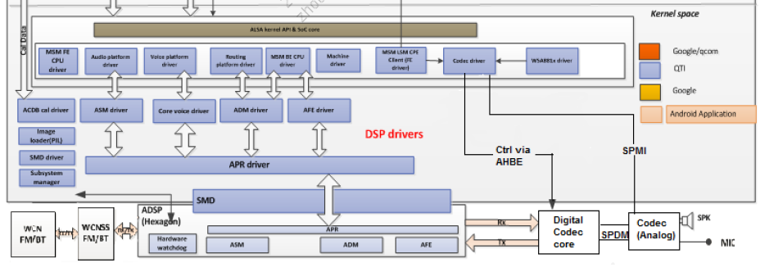

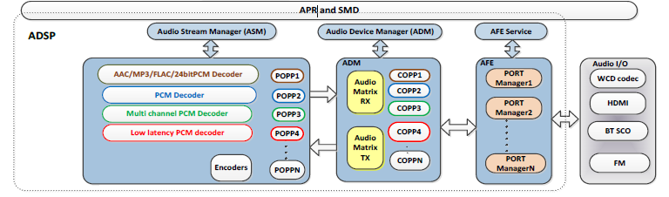
Software Architecture Hal to bellow

Slide 16
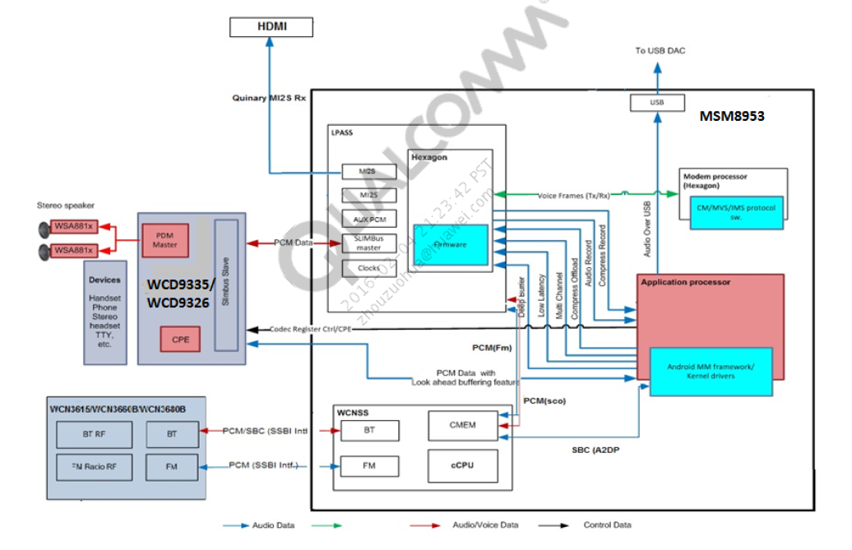
Audio System –Audio Hardware Interfaces and Data Flow

Slide 17
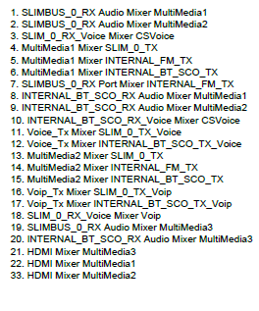
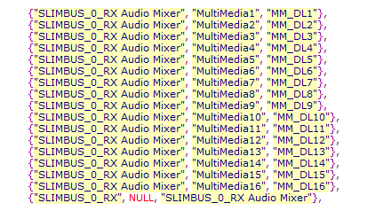
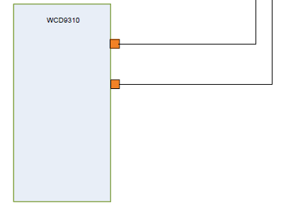
The routing map for the DSP defined as intercon in msm-pcm-routing.c describes the various routing paths or devices to which the different types of streams can be routed. Each record in the table is a collection of three entries. Reading from right to left, the first entry is the audio source, the second is the control (if any), and the third is the audio sink for the corresponding physical hardware route it represents, e.g.:
{"SLIMBUS_0_RX Audio Mixer", "MultiMedia1", "MM_DL1"}
{"SLIMBUS_0_RX", NULL, "SLIMBUS_0_RX Audio Mixer"}
MM_DL1 (Multimedia Downlink 1) is a playback stream that in the first example above is a source that is routed to a mixer in the DSP called SLIMBUS_0_RX Audio Mixer. In the next example, SLIMBUS_0_RX Audio Mixer is the source whose output is routed to the SLIMBUS_0_RX port connected to the hardware codec.
The audio route map describes the various stream routes supported by the DSP firmware.

Slide 19
